Slide 1
Radium transport in groundwater
Michael Chen, Tiffany Wang, Benjamin Kocar
Supergroup September 22nd, 2015
Notes:
Good morning, my name is Michael Chen, and I’ll be presenting some results from our lab’s work on radium sorption to iron minerals.

Slide 2
Two major projects
Radium adsorption experiments->pulled from ACS talk
Microfluidic channel testing early results

Slide 3

Introduction and objectives
Naturally occurring radium isotopes
Natural hazard/tracer with little human use
Wide range of half lives
3 days – 1600 years
2 oxidation states
Goal: Understand geochemistry for better predictions of transport
This talk: Behavior in static systems
Clock using radium for illumination from en.Wikipedia.org/Radium_dials

Slide 4
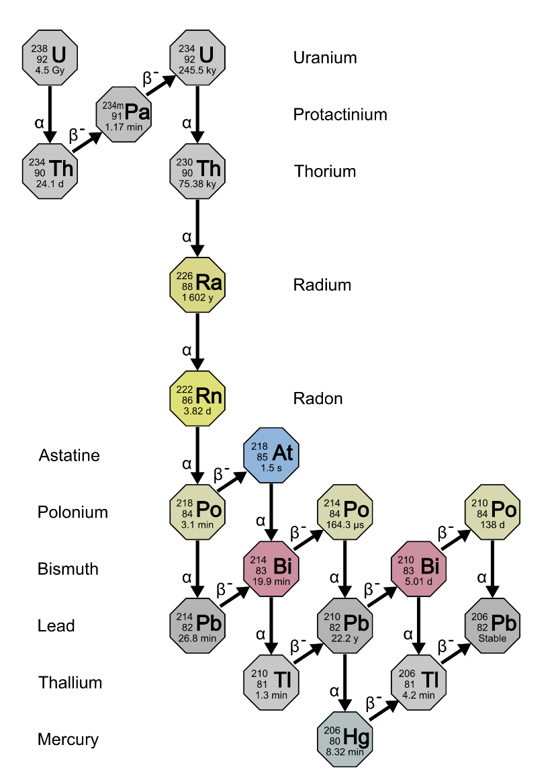
Radium in the environment
Source: ubiquitous parent radionuclides
Activities: <1 DPM/mL
Removal dominated by advection and decay
Extensive adsorption to oxidized iron and manganese minerals
Changing environmental conditions affect transport
Salinity
Redox potential
pH
Uranium Series decay taken from en.Wikipedia.org/Decay_chain

Slide 5
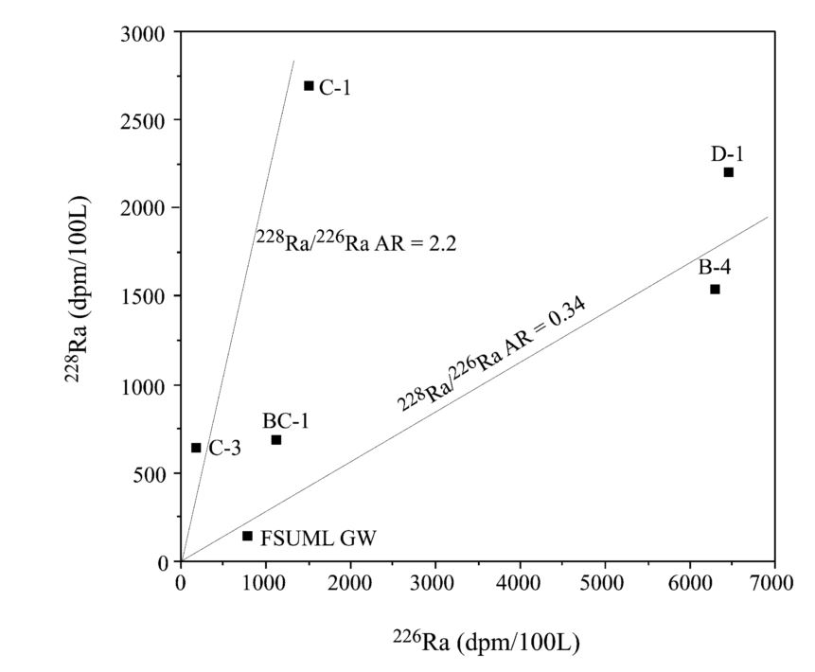
Radium as groundwater flux tracer
Radium isotope mixing model for nearshore system
Source:
Groundwater
Sink:
Decay
Assumes conservative mixing of isotopic ratios
Figure adapted from Moore, 2003, illustrating the identification of radium sources for a nearshore system.

Slide 6
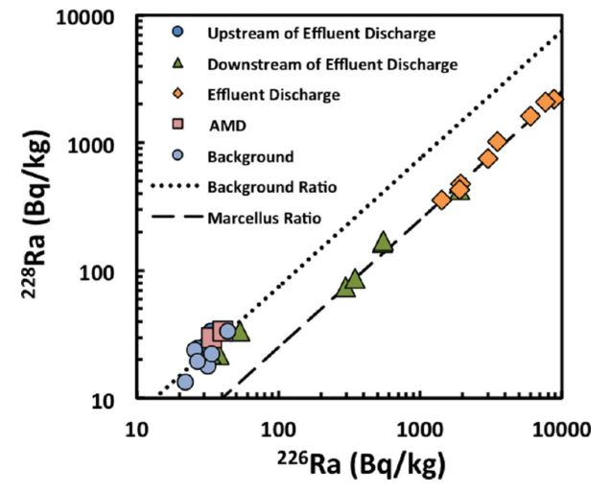
Radium in hydraulic fracturing
Produced water brings radium to surface
Activities: >5000 DPM/mL
Alteration in-situ redox state
Treatment/disposal expensive
Co-precipitation with Barium Sulfate
Improper handling can lead to leakage
Potential to mark contamination events
Figure from Warner et al, 2013 of river sediment radium concentrations near a waste water treatment plant

Slide 7
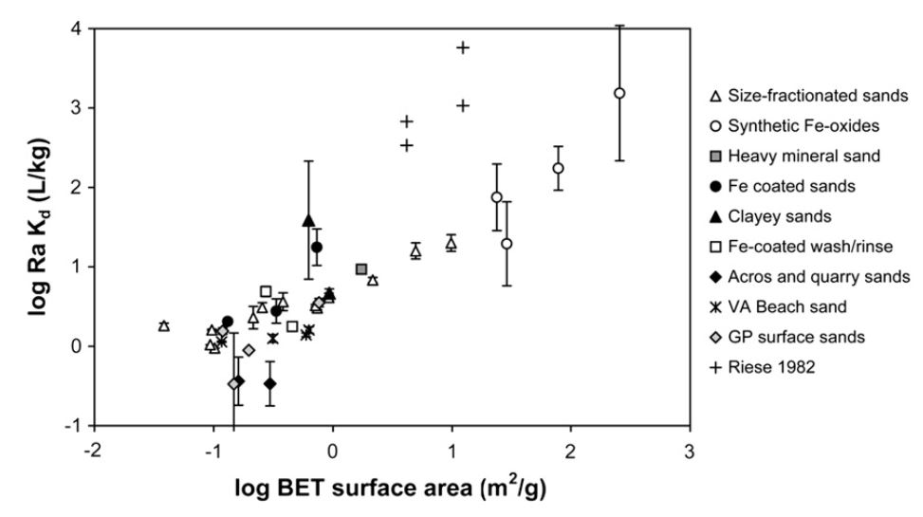
“Historical” data: large variability
DATA SLIDE
Radium sorption to marine sands in seawater from Beck & Cochran, 2013

Slide 8
Central Questions
What are the dominant minerals that retain radium?
How do solution conditions affect radium transport?
How does radium retention change when redox alters minerology and flow field structure?

Slide 9
Experimental Work
Sorption Isotherms
Static (no flow) experiments
Redox alteration
pH envelopes
Flow experiments
Microfluidic cell experiments
Dynamic flow field/geochemistry experiments

Slide 10
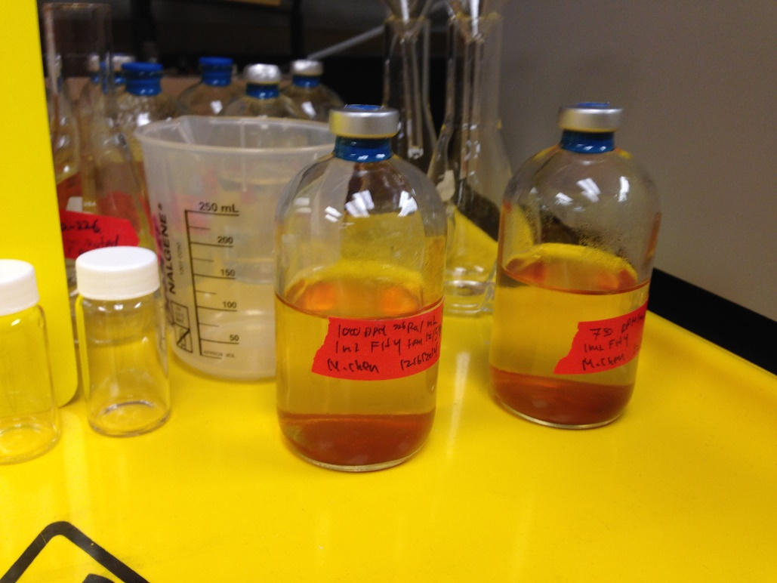
Static Condition Methodology
Synthesized Ferrihydrite, 12 mg in solution
Acid washed, 44-250 um pyrite, 20 mg
24 hour shaking time with 100 mL pH adjusted milliQ water
3000 to 50000 DPM total activity
Radium 226 counted with Scintillation Counter
Two serum vials after a sorption isotherm experiment

Slide 11
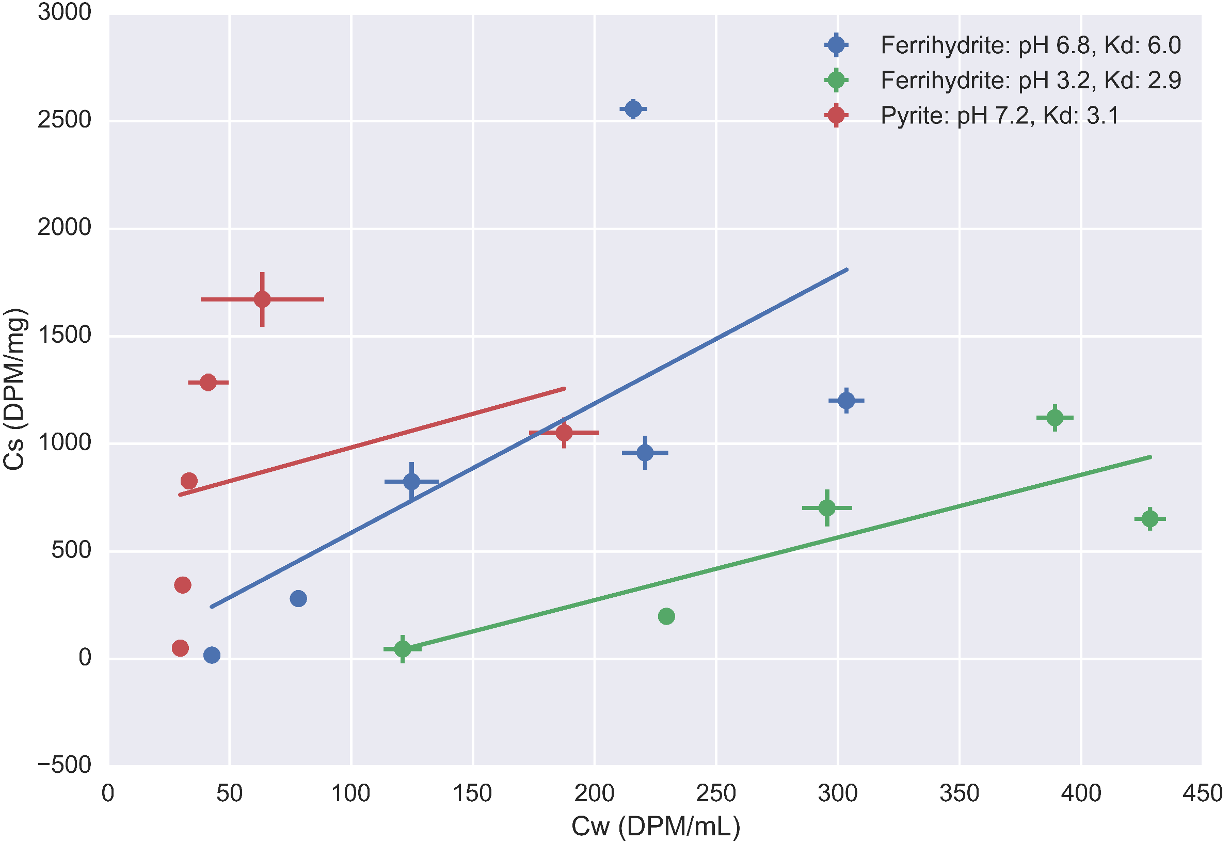

Slide 12
Isotherm discussion
Results
Ferrihydrite: Low pH has lower sorption
Pyrite: Stronger adsorption than ferrihydrite at same pH
Data points in need of clarification
Implications
Ferrihydrite normally considered stronger sorbent
Oxidation of pyrite->desorption of sorbed radium
Need to identify other controlling sorbents

Slide 13
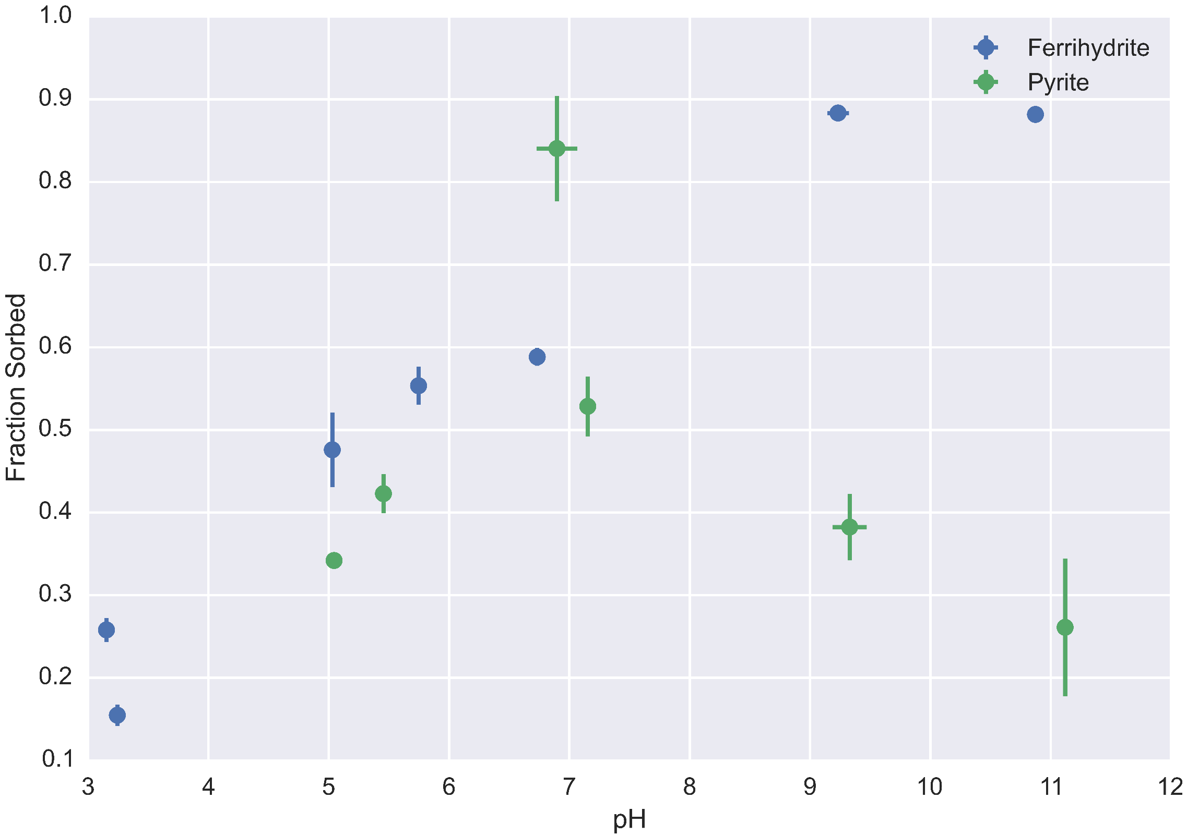

Slide 14
Discussion
Results
Ferrihydrite:
Increasing adsorption with increasing pH, matching isotherm results
Adsorption peaks out
Pyrite:
Maximal sorption at circumneutral pH
Implications
Control pH to control sorption
Mineral specific behavior

Slide 15

Oxidation Experiment Methodology
Pyrite experiment after shaking period
Removal of supernatant for quantification
Addition of 3% hydrogen peroxide
Shaking for 48 hours with controls
Schematic where a pyrite grain is oxidized, forming oxidized iron coatings and potentially releasing radium from the surface

Slide 16
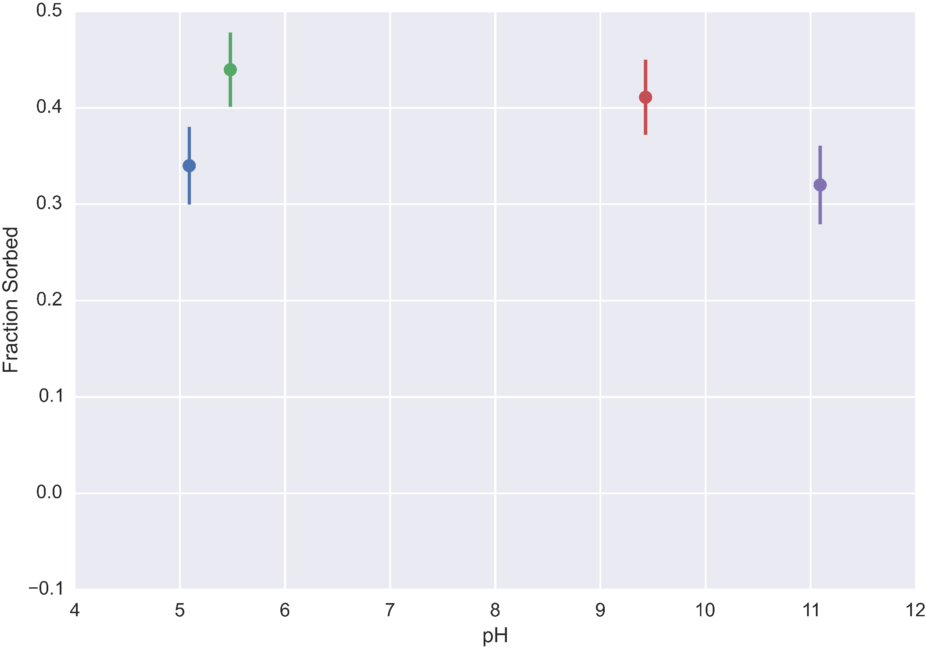
Oxidation Experiment: Before addition of hydrogen peroxide

Slide 17
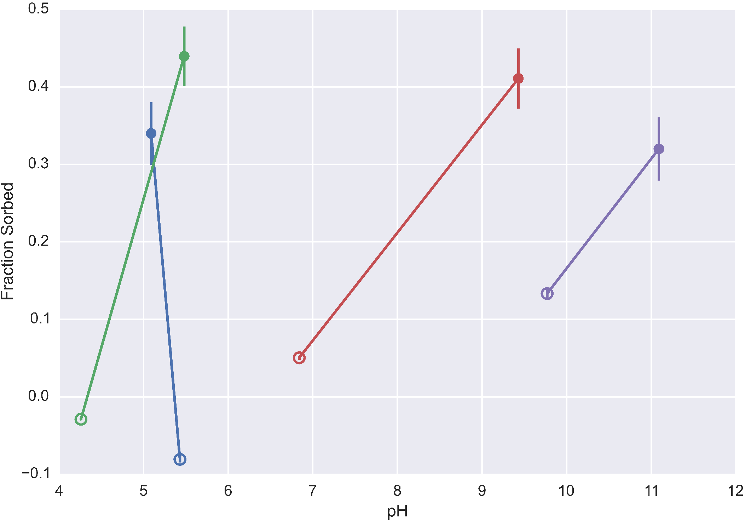
Oxidation Experiment: After hydrogen peroxide addition

Slide 18
Oxidation Experiment: After hydrogen peroxide addition
Radium and Pyrite
Oxidized Pyrite
Notes:
Remember to talk about control, need to rerun this agian

Slide 19
Discussion
Results
Overall decrease in sorption in control and experiment
More desorption with oxidant than without
Decrease in pH->change in sorption, oxidation of pyrite
Implications
Oxic solution can desorb radium from reduced minerals
Ideal retention requires anoxic system at circumneutral pH or oxic system at high pH

Slide 20
Current Difficulties
Scintillation counting not discriminating between radium 226 and daughter products
Counts for standard increase over time
Counts may be incorrect depending on when they were run->should have info to compensate
How does procedure affect presence of daughter products?
Gamma counting able to differentiate radium from daughter products?
Slow sample processing rate

Slide 21
Flow condition methodology
Analyze impacts of changing geochemistry on transport and flow
Develop microfluidic channels that can be run/used at synchrotron facilities
Still working on materials for channels
These images: PDMS structure with glass backing
Simple, fast chemistry: Manganese with H2O2

Slide 22
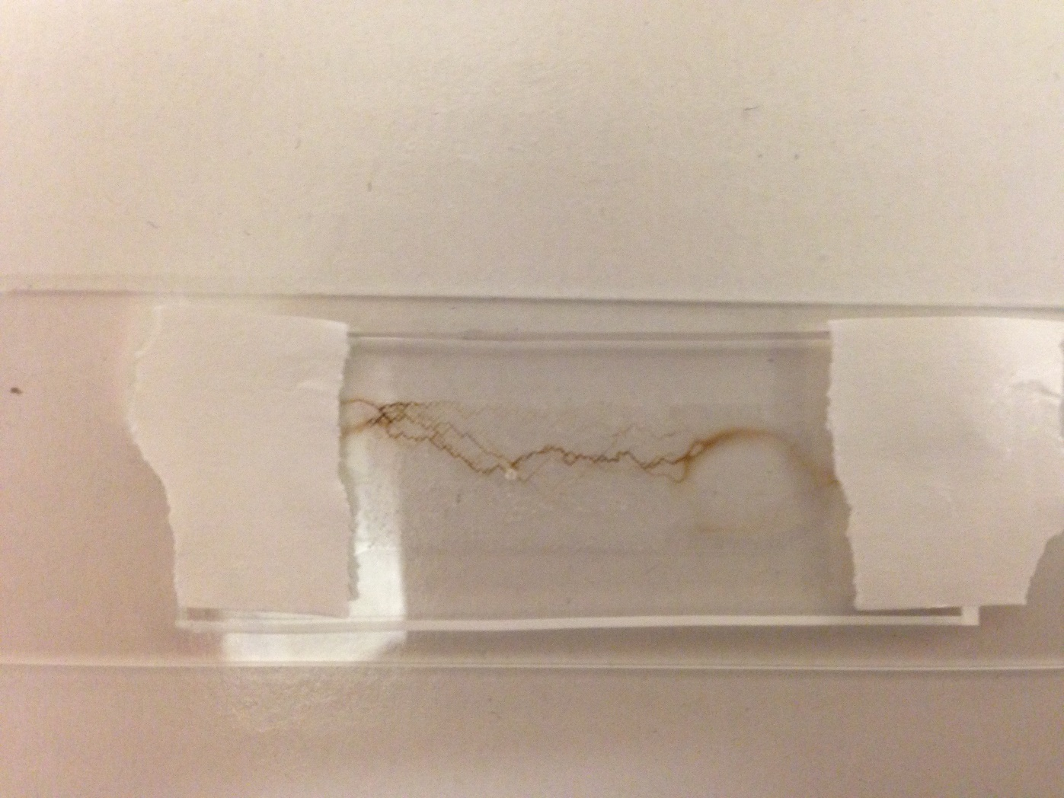
Test cell: Success!

Slide 23
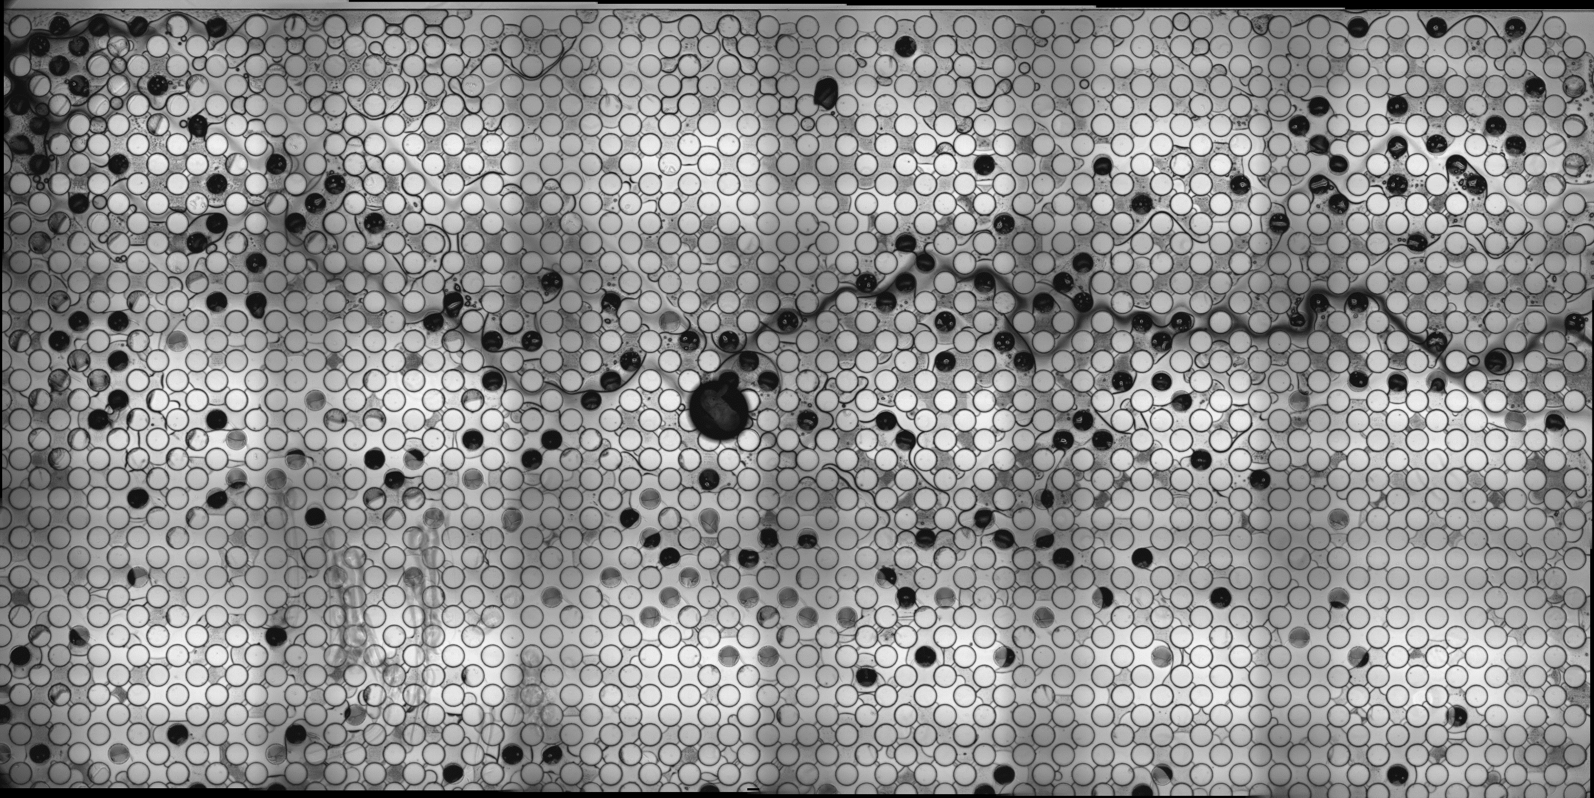

Slide 24
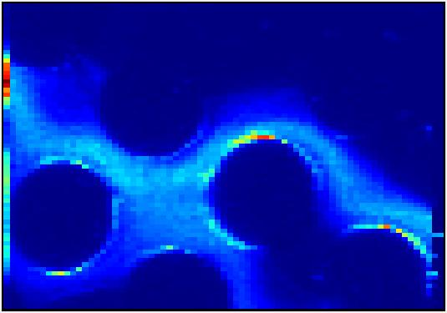
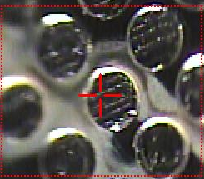
Synchrotron Imaging: Mn Channel
300 uM

Slide 25
Difficulties
PDMS and glass strongly absorb X-Rays at Fe/Mn K edge energies
Images taken by scraping PDMS off of cell
PDMS not a representative material of porous media
Fabrication not ideal for channel geometry (aberrations)
Try to use silicone wafer as flow cell with thin glass cover

Slide 26
Conclusions
Quantified pyrite and ferrihydrite sorption behavior
Radium sorbs more extensively to pyrite than ferrihydrite
Minerals have pH dependent behavior
Sensitive partitioning behavior
Strong dependence on mineral
Flux of oxic solution into anoxic system can induce radium release
Control solution chemistry to enhance retention

Slide 27
Future Work
Expand isotherms:
Salinity
Surface complexation modeling
Study radium partitioning in microfluidic channel

Slide 28
Acknowledgements
MIT Radiation Protection Office
Roman Stocker, Roberto Rusconi
Kocar Lab
SSRL

Slide 29
Works Cited
Beck, A. J., & Cochran, M. a. (2013). Controls on solid-solution partitioning of radium in saturated marine sands. Marine Chemistry, 156, 38–48. doi:10.1016/j.marchem.2013.01.008
Moore, W. S. (2003). Sources and fluxes of submarine groundwater discharge delineated by radium isotopes. Biogeochemistry, 66(1), 75–93. doi:10.1023/B:BIOG.0000006065.77764.a0
Warner, N. R., Christie, C. a., Jackson, R. B., & Vengosh, A. (2013). Impacts of shale gas wastewater disposal on water quality in Western Pennsylvania. Environmental Science and Technology, 47, 11849–11857. doi:10.1021/es402165b
Wikipedia. (2014, November 21). Retrieved from https://en.wikipedia.org/

